Slide 1
REDUCING DATA TRANSFER ENERGY BY EXPLOITING SIMILARITY WITHIN A DATA TRANSACTION
Donghyuk Lee, Mike O’Connor, Niladrish Chatterjee

Slide 2
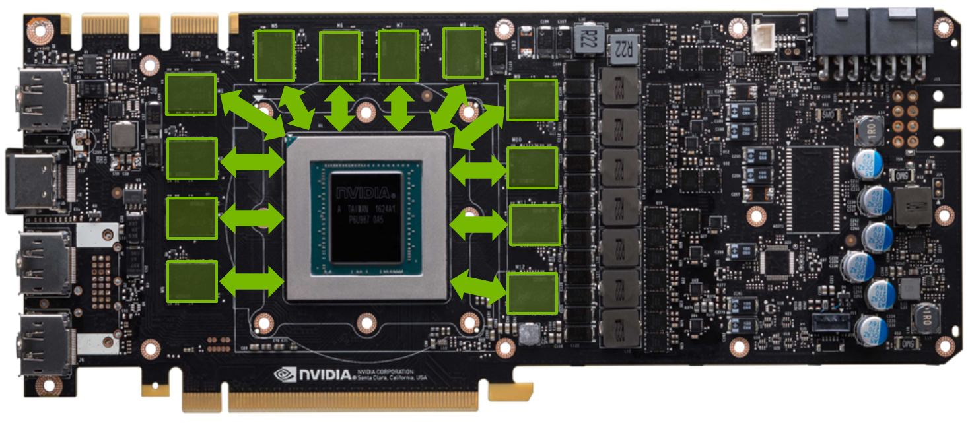
GPU with 384-bit wide DRAM Interface

Slide 3
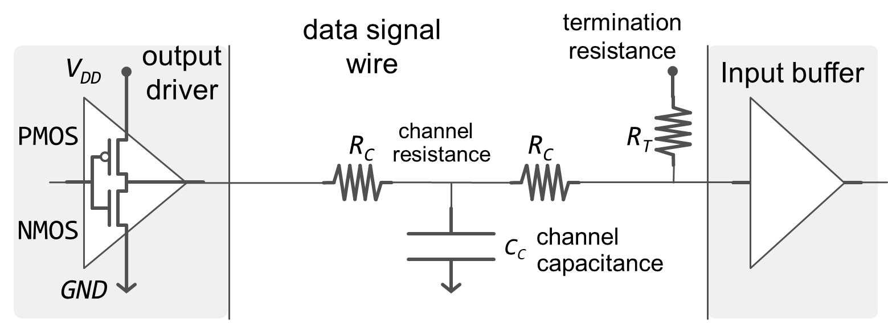
Terminated Pseudo-Open-Drain I/O
Transmitting a ‘0’ value
Transmitting a ‘1’ value

Slide 4
Terminated Pseudo-Open-Drain I/O
Transmitting a ‘0’ value

Slide 5
Basic Idea
Fewer ‘1’ bits in the data
Less energy required on DRAM interface
Is there a simple & effective encoding to reduce the number of ‘1’ bits?

Slide 6
Typical 32B cache sector/DRAM burst
01000000010010010000111111011011
01000000110111110101101101111110
01000001000111011110100111100110
01000000100011100010011010011010
01000000011010010000111111011011
00000000000000000000000000000000
00111111101101001111110111110100
00111111111111111110110000110101
Consists of eight 32-bit data elements

Slide 7
Typical 32B cache sector/DRAM burst
01000000010010010000111111011011
01000000110111110101101101111110
01000001000111011110100111100110
01000000100011100010011010011010
01000000011010010000111111011011
00000000000000000000000000000000
00111111101101001111110111110100
00111111111111111110110000110101
Many instances of data similarity between adjacent data elements

Slide 8
Base + XOR Transfer
Base value
01000000010010010000111111011011
01000000110111110101101101111110
01000001000111011110100111100110
01000000100011100010011010011010
01000000011010010000111111011011
00000000000000000000000000000000
00111111101101001111110111110100
00111111111111111110110000110101
01000000010010010000111111011011
00000000100101100101010010100101
00000001110000101011001010011000
00000001100100111100111101111100
00000000111001110010100101000001
01000000011010010000111111011011
00111111101101001111110111110100
00000000010010110001000111000001
XOR
[8] K. Lee, S.-J. Lee, and H.-J. Yoo, “SILENT: Serialized Low Energy Transmission Coding for On-chip Interconnection Networks,” in ICCAD, 2004.
121 ‘one’ values
109 ‘one’ values
10% Savings

Slide 9
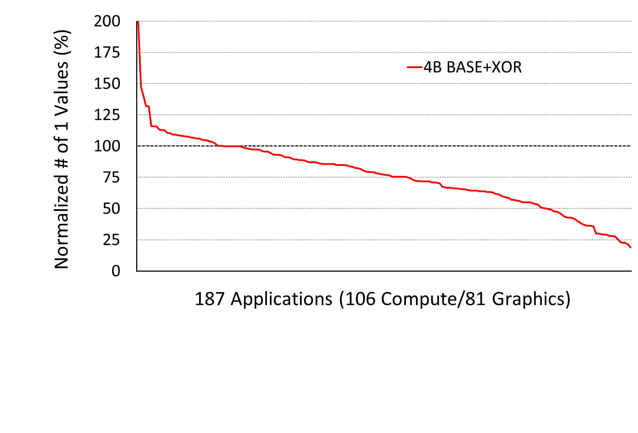


How are we doing?
18% of apps get worse
Avg. 29% reduction in # of ‘1’s

Slide 10
Challenge #1: Zero Data Values
01000000010010010000111111011011
01000000010010010000111111011011
01000001000111011110100111100110
01000001000111011110100111100110
01000000011010010000111111011011
01000000011010010000111111011011
00111111101101001111110111110100
00111111101101001111110111110100
01000000010010010000111111011011
00000000000000000000000000000000
01000001000111011110100111100110
00000000000000000000000000000000
01000000011010010000111111011011
00000000000000000000000000000000
00111111101101001111110111110100
00000000000000000000000000000000
2×
more
‘1’ bits
Zero-valued elements mixed with non-zero data can cause significant increases in ‘1’s

Slide 11
Zero Data Remapping
B
01000000010010010000111111011011
Z
00000000000000000000000000000000
B
01000000010010010000111111011011
B
Z = B
C
C
00000000000010000000000000000000
(an arbitrary low-weight constant)
B
A = C
B
B
01000000010010010000111111011011
A
01000000010000010000111111011011
A = B
C
C
00000000000010000000000000000000
B
01000000010010010000111111011011

Slide 12
Zero Data Remapping
01000000010010010000111111011011
00001000000000000000000000000000
01000001000111011110100111100110
00001000000000000000000000000000
01000000011010010000111111011011
00001000000000000000000000000000
00111111101101001111110111110100
00001000000000000000000000000000
01000000010010010000111111011011
00000000000000000000000000000000
01000001000111011110100111100110
00000000000000000000000000000000
01000000011010010000111111011011
00000000000000000000000000000000
00111111101101001111110111110100
00000000000000000000000000000000
4
more
‘1’ bits
(1.5%)
Zero-valued elements cause limited increase

Slide 13
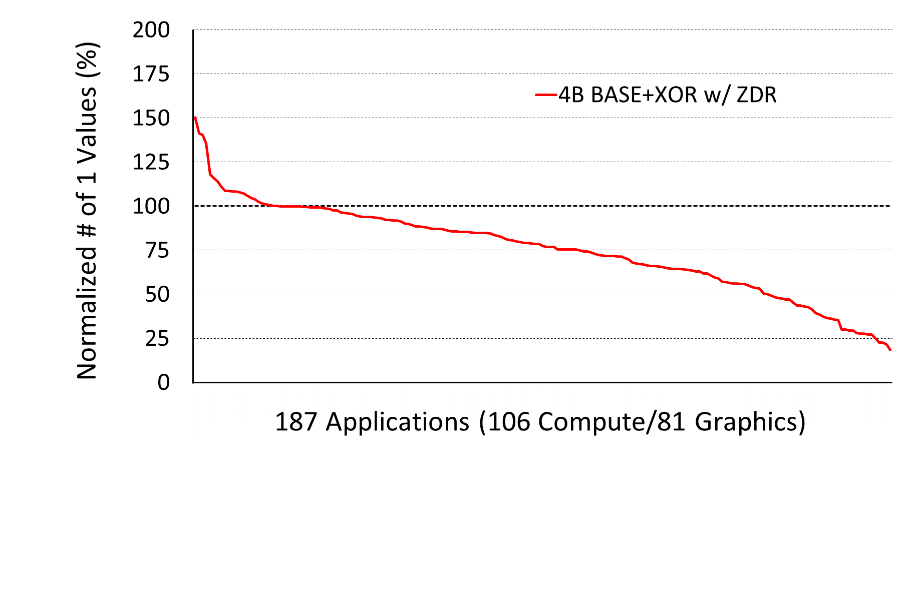
How are we doing now?
12% of apps get worse (was 18%)
Avg. 30% reduction in # of ‘1’s (was 29%)

Slide 14
Challenge #2: Granularity of Data
Little similarity at
32-bit granularity
01000000000010010010000111111011
01010100010001000010110100011000
01000000000110111110101101101111
10110000010111000110110011110110
01000000001000111011110100111100
11001001101111100100010111011110
01000000000100011100010011010011
00111001110010001100011011001011
Consists of four 64-bit data elements

Slide 15
Challenge #2: Granularity of Data
01000000000010010010000111111011
01010100010001000010110100011000
01000000000110111110101101101111
10110000010111000110110011110110
01000000001000111011110100111100
11001001101111100100010111011110
01000000000100011100010011010011
00111001110010001100011011001011
01000000000010010010000111111011
00010100010011010000110011100011
00010100010111111100011001110111
11110000010001111000011110011001
11110000011111111101000111001010
10001001100111011111100011100010
10001001101011111000000100001101
01111001110110010000001000011000
117 ‘one’ values
122 ‘one’ values
4% worse w/ wrong granularity

Slide 16
Challenge #2: Granularity of Data
Perform XOR at 64-bit granularity
01000000000010010010000111111011
01010100010001000010110100011000
01000000000110111110101101101111
10110000010111000110110011110110
01000000001000111011110100111100
11001001101111100100010111011110
01000000000100011100010011010011
00111001110010001100011011001011
01000000000010010010000111111011
01010100010001000010110100011000
00000000000100101100101010010100
11100100010110000100000111101110
00000000001110000101011001010011
01111001111000100010100100101001
00000000001100100111100111101111
11110000011101101000001100010101
117 ‘one’ values
103 ‘one’ values
12% savings w/ correct granularity

Slide 17
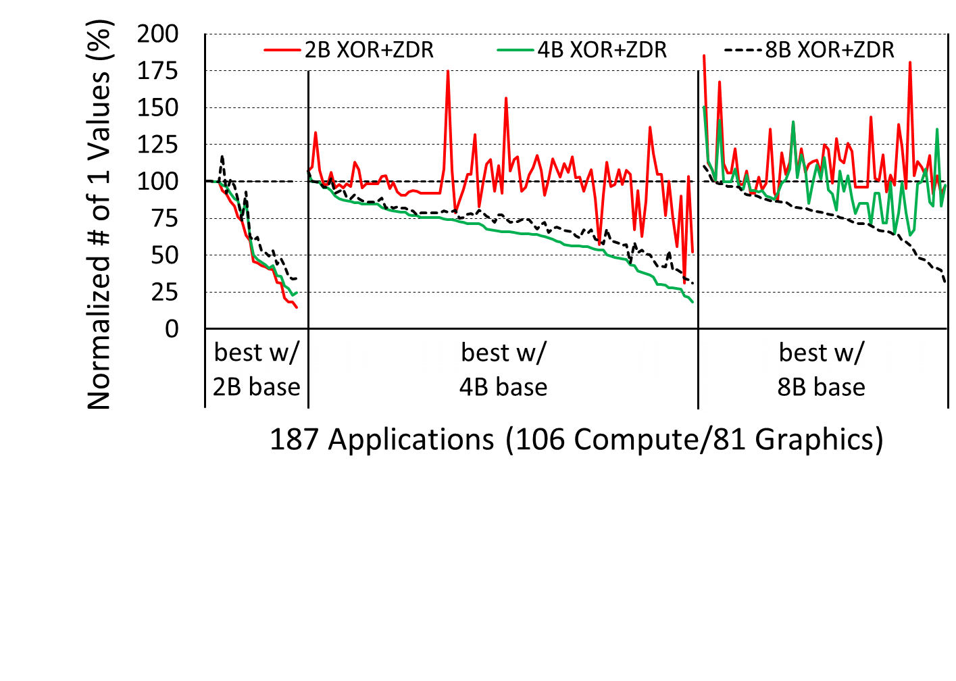
Dynamic selection of granularity?
8B isn’t too bad even
when 2B or 4B is best

Slide 18
Observation Similarity of 2B and 4B elements can be exploited at 8B granularity
similarity in
N-byte elements
3901
3903
3905
3907
3909
390b
390d
390f
similar
similarity in
2N-byte elements
3901 3903
3905 3907
3909 390b
390d 390f
similar
similarity in
4N-byte elements
3901 3903 3905 3907
3909 390b 390d 390f
similar

Slide 19
Universal Base
Missed opportunity
01111001000000010111100100000011
01111001000001010111100100000111
01111001000010010111100100001011
01111001000011010111100100001111
01111001000100010111100100010011
01111001000101010111100100010111
01111001000110010111100100011011
01111001000111010111100100011111
01111001000000010111100100000011
01111001000001010111100100000111
00000000000010000000000000001000
00000000000010000000000000001000
00000000000110000000000000011000
00000000000110000000000000011000
00000000000010000000000000001000
00000000000010000000000000001000
Perform Base + XOR transform on 8B granularity

Slide 20
Universal Base
01111001000000010111100100000011
01111001000001010111100100000111
00000000000010000000000000001000
00000000000010000000000000001000
00000000000110000000000000011000
00000000000110000000000000011000
00000000000010000000000000001000
00000000000010000000000000001000
01111001000000010111100100000011
00000000000001000000000000000100
00000000000010000000000000001000
00000000000010000000000000001000
00000000000110000000000000011000
00000000000110000000000000011000
00000000000010000000000000001000
00000000000010000000000000001000
01111001000000010000000000000010
Perform Base + XOR transform on 8B granularity
Perform 4B granularity transform within 8B base
Perform 2B granularity transform within 4B base

Slide 21
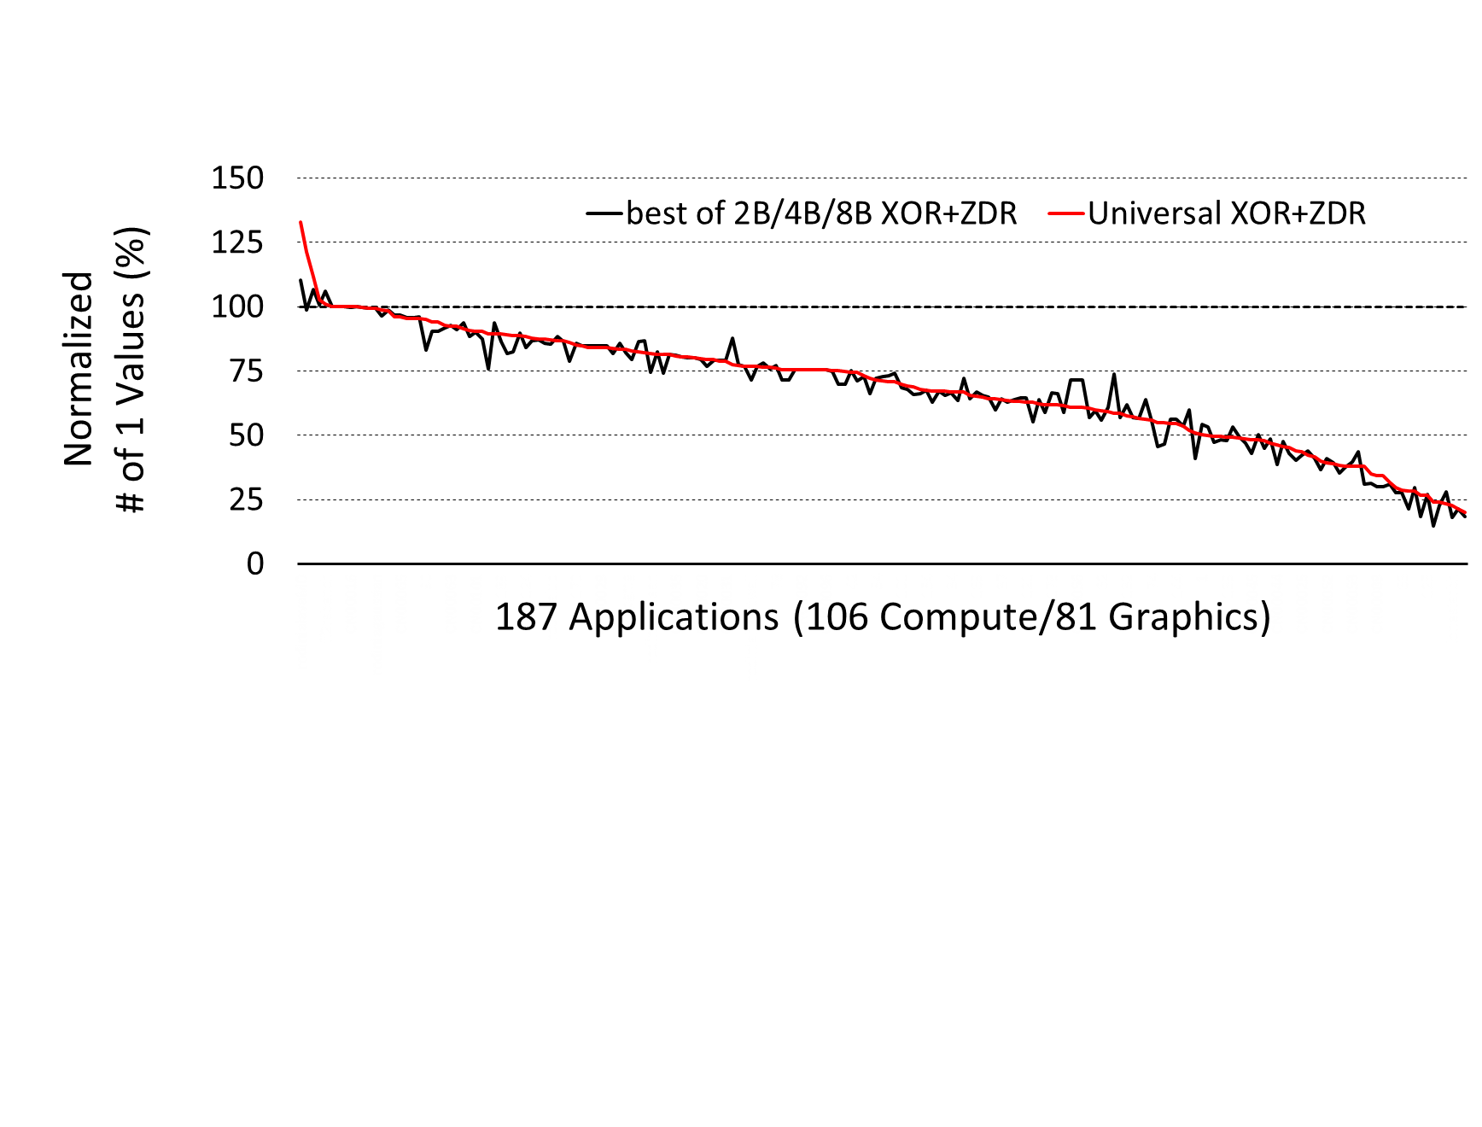
Now, how are we doing?
3.7% of apps get worse (was 12%)
Avg. 35% reduction in # of ‘1’s (was 30%)

Slide 22
What’s up with the 33% Increase?
00000000000000000000000011010010
00000000000000000000000000000000
00000000110100100000000000000000
00000000000000000000000000000000
00000000000000001101001000000000
00000000000000000000000000000000
11010010000000000000000000000000
00000000000000000000000000000000
00000000000000000000000011010010
00001000000000000000000000000000
00000000110100100000000000000000
00001000000000000000000000000000
00000000000000001101001000000000
00001000000000000000000000000000
11010010000000000000000000000000
00001000000000000000000000000000
4
more
‘1’ bits
due to
ZDR
Very few 1’s to begin with
16 ones -> 20 ones (6%->8%)
A 33% increase in ‘1’s

Slide 23
What’s up with the 33% Increase?
Very small
Power increases

Slide 24
Secondary Effect: Switching Reduction
Fewer ‘1’ values reduces the probability of a 1→0 or 0→1 transition on the bus
Across our benchmarks we see a 23% reduction on average in switching activity
Also saves power on the interface due to charging/discharging the channel capacitance
Good for unterminated/on-chip bus, too!

Slide 25
Synergy with DBI
01000000 01001001 00001111 11011011
01000000 11011111 01011011 01111110
01000001 00011101 11101001 11100110
01000000 10001110 00100110 10011010
01000000 01101001 00001111 11011011
00000000 00000000 00000000 00000000
00111111 10110100 11111101 11110100
00111111 11111111 11101100 00110101
01000000:0 01001001:0 00001111:0 00100100:1
01000000:0 00100000:1 10100100:1 10000001:1
01000001:0 00011101:0 00010110:1 00011001:1
01000000:0 10001110:0 00100110:0 10011010:0
01000000:0 01101001:0 00001111:0 00100100:1
00000000:0 00000000:0 00000000:0 00000000:0
11000000:1 10110100:0 00000010:1 00001011:1
11000000:1 00000000:1 00010011:1 00110101:0
Data Bus Inversion adds a bit of metadata and conditionally inverts data if more than 50% are ‘1’s
Reduces SSO by limiting diff. between min/max power

Slide 26
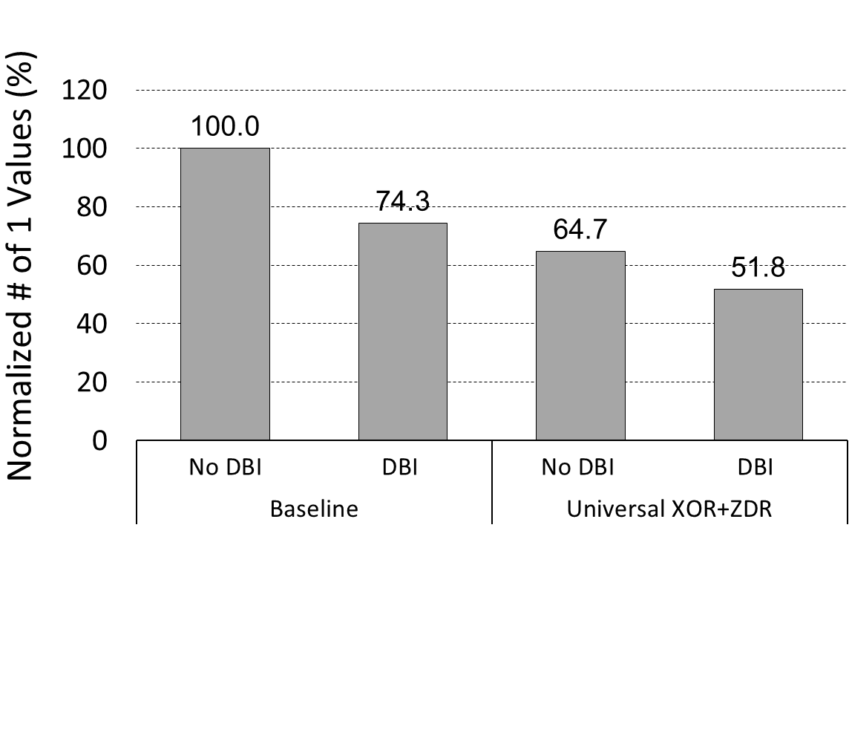
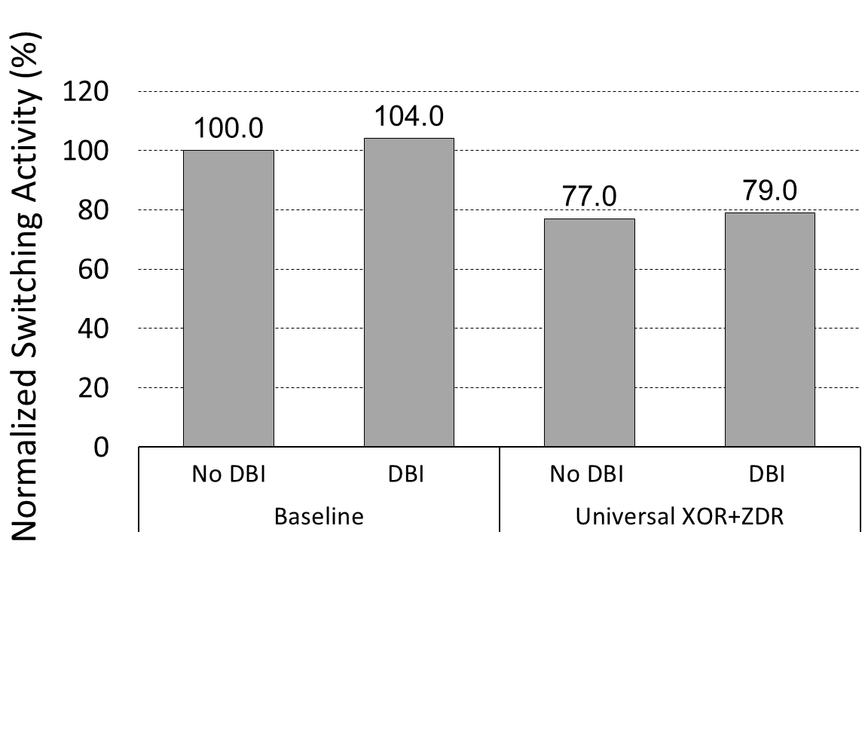
Synergy with DBI
We reduce 1’s by 30% over DBI and reduce switching 24%

Slide 27
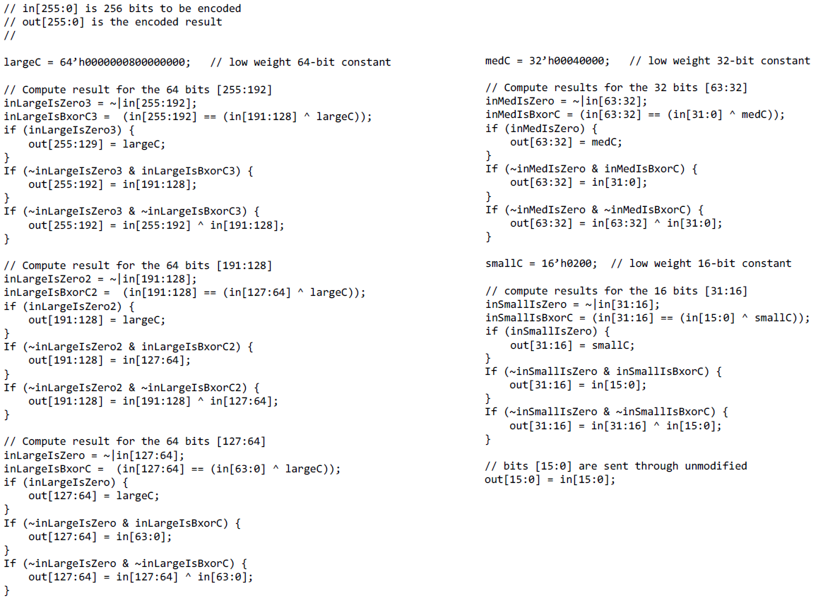
Implementation costs
Very simple to implement
Verilog for encoder:
(45 non-comment lines)
Encoder + Decoder
2,232 µm²
(16nm FinFet process)
0.027mm² total for
384-bit DRAM interface

Slide 28
Overall DRAM Energy Savings
Detailed model of GDDR5X DRAM system
Assumes 70% utilization
Typical traffic patterns
(e.g. R/W mix, activation rate)
Modeling reduction of 1’s and switching activity
Incremental power for encoder/decoder logic
Saves 4.4% of total GDDR5X DRAM system energy

Slide 29
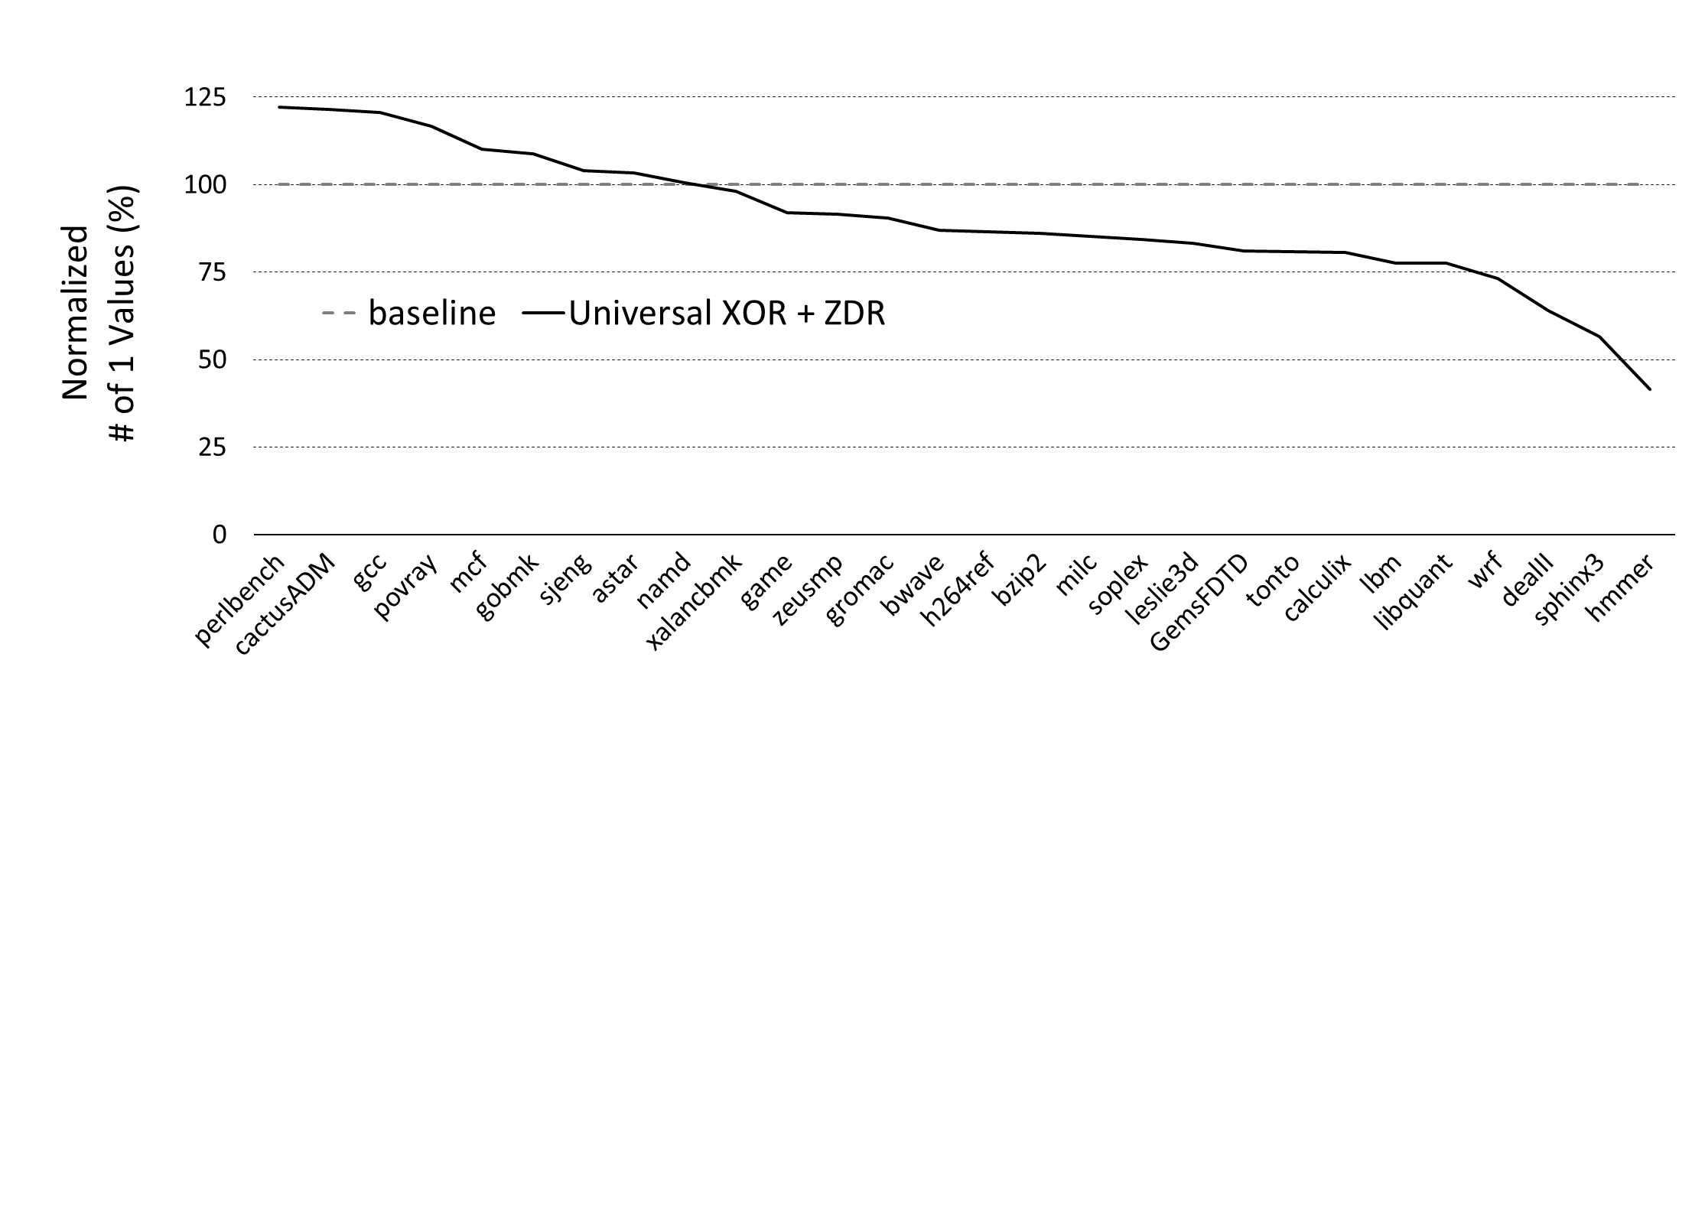
Great! What about for CPUs?
32% of apps get worse
Avg. 12% reduction in # of ‘1’s

Slide 30
Why aren’t CPUs seeing the benefits?
Array of Structs
struct Circle {
int color;
float radius;
int x;
int y;
}
Circle circles[1000];
Struct of Arrays
struct Circles {
int color[1000];
float radius[1000];
int x[1000];
int y[1000];
}
Typical GPU/SIMD coding style keeps data of the same type/content together
Typical CPU coding style interleaves data of different types/contents in memory
Breaks premise of adjacent data elements being similar

Slide 31
Conclusions
Simple, cheap, & easy to implement
No additional metadata or code-storage SRAMs
Works with off-the-shelf DRAMs today
Reduces number of 1’s by 30-35% (depending on DBI)
Reduces switching activity 23-24% (depending on DBI)
Applicable to any bus transferring predominantly vector data (e.g. for GPUs or data for SIMD units)
But especially good for terminated buses –
e.g. Saves 4.4% total DRAM energy for GDDR5X

